Slide 1
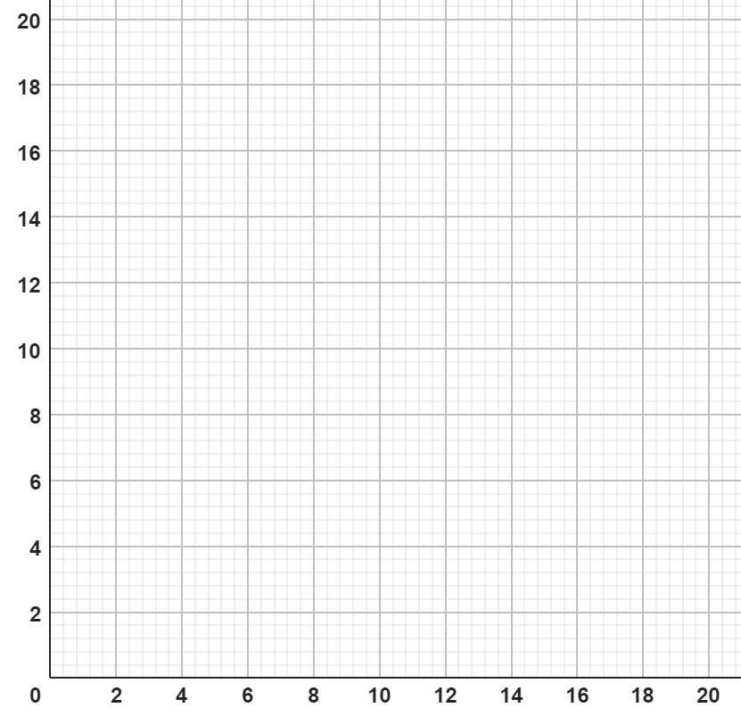
Describing exchange rates with ratio
Task A: Representations of exchange rates
1) Draw a graph and estimate the conversions.
a) £10 = $15
b) £8 = €10
$
€
£
£
£8 = $ .
£6 = € .
$6 = £ .
€4 = £ .
c) £14 = €18
d) £16 = $18
€
$
£
£
£5 = € .
£11 = $ .
€16 = £ .
$8 = £ .

Slide 2

Describing exchange rates with ratio
Task B: Writing exchange rates as a ratio
1) Find the missing values in the following tables given the exchange rate in the top row.
a)
b)
c)
£ | €
1 | 1.15
280
$ | £
1 | 0.79
50
£ | ¥
1 | 185
15
d)
€ | £
1 | 0.9
 | 22.50
e)
£ | ¥
1 | 185
 | 2312.50
f)
£ | $
1 | 1.25
 | 108.75
2) Andeep is comparing prices of sunglasses in the UK, the USA and France.
Rank the following from cheapest to most expensive.
£45.00
$57.00
£1 : $1.25
€54.24
£1 : €1.20
£ | $
1 | 1.25
 | 57
£ | €
1 | 1.20
 | 54.24
Mathematics in Education and Industry
v2.3

